Slide 1


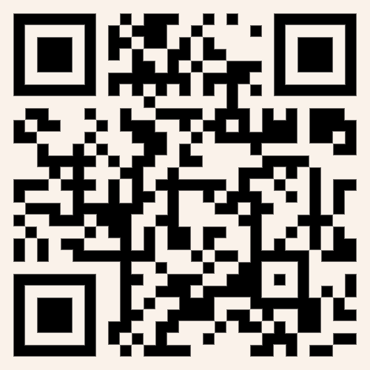
Music Innovation Fund - Webinar
Notes:
Pete

Slide 2

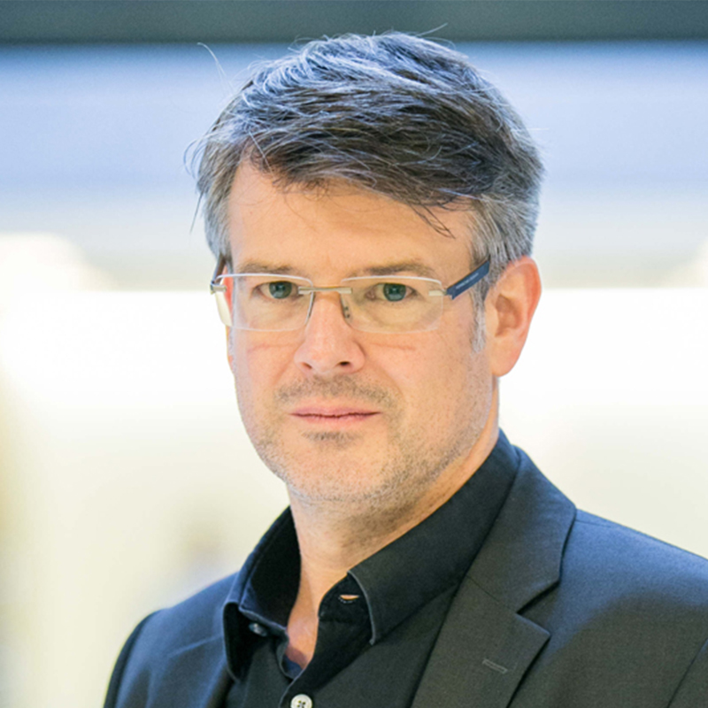

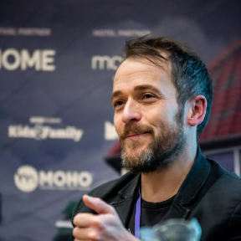

Introductions
Yaw Owusu, Enterprise Lead​
Richard Koeck,
Director
Hatana El-Jarn, ​
Co-Lead LJMU
Pete Woodbridge,
R&D Innovation Lead
Notes:
Pete + ALL

Slide 3

Agenda
About MusicFutures
Fund Criteria, Eligibility & Timeline
What we are looking for
Q&A- pop in your questions
Notes:
Pete

Slide 4

Notes:
Richard

Slide 5







What is MusicFutures?
Notes:
Richard

Slide 6
Mission
MusicFutures … is driving the next generation of the music industry across the Liverpool City Region — supporting artists, entrepreneurs and creative businesses to grow, innovate and thrive.
Notes:
Richard

Slide 7
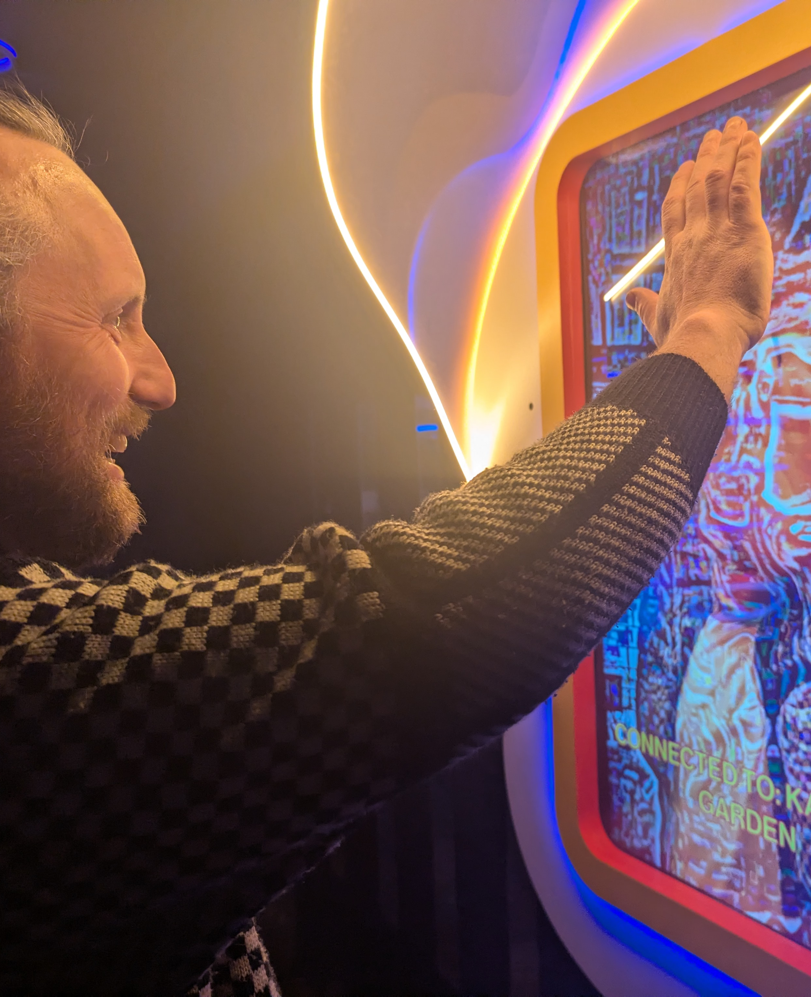
Innovation & R+D
Powering music innovation by linking creative talent with advanced research and technology to develop future-ready products, services and experiences.
Skills & Talent
Developing the next generation of diverse music talent by providing high-quality training, professional development and access to research, technology and industry expertise.
Entrepreneurship
Driving entrepreneurship in the music sector by enabling SMEs, entrepreneurs and artists to innovate, grow, attract investment and create resilient, sustainability.
Policy & Research
Shaping the future of the music sector through research and policy development that supports a fair, inclusive and thriving ecosystem.
Notes:
Richard

Slide 8
Music Innovation Fund
MusicFutures is launching the first round of its Innovation Fund to support small and medium-sized enterprises (SMEs) developing the next generation of inclusive and sustainable music technologies, experiences, tools, and business models.
We are looking to support ambitious, forward-thinking projects across the Liverpool City Region (LCR) that have the potential to transform the music sector. Your project can be at any stage.
Notes:
Yaw

Slide 9
What's on Offer?
Successful applicants will receive:
Up to £20,000 in direct financial support
Additional business support (Bootcamps/Mentoring)
The fund will help you to develop, prototype, test, or launch an idea for scalable products, services, processes or experiences.
Notes:
Yaw

Slide 10
Eligibility
Who Can Apply
• Registered SMEs or CICs
• Based in, or have significant presence in, the Liverpool City Region.
• Proposing a music innovation with a clear route to real-world use, commercialisation, and sector impact
Not eligible to lead:
• Publicly funded organisations, non-profits without commercial focus, charities, schools, colleges, or universities cannot lead applications. However, they may be partners if the lead organisation is an eligible company
Notes:
Pete

Slide 11
What we can fund
We are seeking projects that push boundaries in how music is created, performed, distributed, monetised, or experienced;
With intention to also impact on:
a) improving environmental sustainability and/or:
b) increasing diversity, inclusivity and equality in the sector.
Notes:
Pete

Slide 12
New Business Models and Platforms
• Fan engagement platforms
• New ways of working with data
• New monetisation models (co-ops, creator economy tools, micropayments)
• Innovations supporting artist livelihoods and fairer value flows
Notes:
Pete

Slide 13
New Production Technologies
• Realtime, interactive and virtual production for music content
• Spatial audio, adaptive music, immersive experiences
• Workflow automation and next-gen music production pipelines
Notes:
Pete

Slide 14
Immersive & Interactive Experiences
• New immersive formats for live and digital music
• Multisensory installations, interactive concerts
• Location-based media and music-focused digital twins
Notes:
Pete

Slide 15
Tools and Innovations for Live,
Studio, or Education
• New hardware/software for recording or performance
• Innovations and tools supporting music education, skills, wellbeing and workforce development
• Accessibility innovations for artists, music professionals and audiences.
• Human Centred AI-native tools for artists, performers, and producers
• Generative audio/video workflows, creative agents, recommendation systems
• Tools supporting rights, authenticity, provenance, ethics, or transparency
Notes:
Pete

Slide 16
IP, Rights and Metadata
• Improving the way that metadata is created, managed, and used
• Tools supporting better ways of managing rights, authenticity, provenance, ethics, or transparency (particularly in relation to ie AI)
Notes:
Pete

Slide 17
What we cannot fund
This funding is to support Innovation in music. Unfortunately, we cannot fund work that:
Is production only (i.e. recording an album, doing a one off show, content creation, marketing and advertising, day to day business operation costs).
Where there is no clear R&D, innovation or development proposed.
Travel/touring costs where travel/touring is the main purpose of the spend. However, you are allowed travel as part of your R&D/Innovation activity.
Notes:
Pete

Slide 18
What we cannot fund
Is not clearly of significant benefit to the music sector. Music industry innovation must be in the centre of the proposition.
Events and one-off experiences. Your innovation needs to demonstrate potential for scalability and sustainability beyond the life of the funding.
Music Education/Support/Skills/Community programmes, however we are encouraging applications that are education centred i.e. leading to new products and services that help people learn.
Notes:
Pete

Slide 19
Selection & Assessment Criteria
We are looking for projects that demonstrate clear novelty, sector benefit and potential for impact.
Projects should seek to improve outcomes for musicians, creators, or industry professionals, address real market opportunities, and show potential for scalability and growth.
Notes:
Hatana

Slide 20
Selection & Assessment Criteria
1. Strategic Alignment
• Does the opportunity align with MusicFutures' mission and long-term goals?
• Does it support innovation, diversity, and sustainability in the music industry?
• Is it consistent with current priority areas (e.g., emerging talent, technology, audience development, inclusivity)?
2. Market Potential and Audience Reach
• Is there a clear target audience and demand for the proposed work?
• Does the opportunity demonstrate potential for growth or scalability?
• Are there route to market plans including marketing, distribution, or audience engagement?
Notes:
Hatana

Slide 21
Selection & Assessment Criteria
3. Financial Viability
• Is the budget realistic, value for money and well-structured?
• Are there other sources of funding, co-investment or revenue streams to support the project?
• Does the project demonstrate sustainability beyond initial funding?
• Is there potential for return on investment?
4. Innovation and Future Readiness
• Does the project leverage new opportunities, with technologies or innovative practices?
• Does the project address a challenge, or opportunity for the music sector in a novel way?
• Will it prepare the music sector for future trends (e.g., audience changes, digital platforms, immersive experiences, new production processes)?
• Does it encourage experimentation and risk-taking in a managed and responsible way?
Notes:
Hatana

Slide 22
Selection & Assessment Criteria
5. EDI and Environmental Responsibility
• Does the project promote inclusivity and equity?
• Are there measures to minimise environmental impact?
• Does it contribute positively to community development?
• Is the team inclusive and diverse?
6. Track Record and Capability
• Does the applicant have the skills, experience, and resources to deliver successfully?
• Are partnerships or collaborations in place to strengthen delivery?
• Is there evidence of past success or learning from previous projects?
Notes:
Hatana

Slide 23
Further Details
Project funding will be administered by University of Liverpool Through subgrant agreement (standard terms on website).
Projects are funded at 100% of project costs, inclusive of VAT, including labour (staff), materials, subcontractors, equipment and other costs
It will be paid in instalments- check the schedule
Equipment costs — maximum of 20% of project grant for equipment and capital purchase costs.
Subcontracting— up to 70% maximum subcontracting costs, with a maximum 30% outside of Liverpool City Region
Projects must comply with Minimal Financial Assistance subsidy controls.
We want to see diverse and inclusive teams.
Projects with additional co-investment (in kind, cash + business contributions)
will be looked on favourably. 1:1 Co-Investment.
Notes:
Pete

Slide 24
Expected Outputs
Development, testing and demonstration of a music innovation prototype, product, experience or service.
Project documentation and visual assets about the project
Internal mid-project and end-of-project reports, and attendance at regular monthly progress meetings.
Contribution to future MusicFutures events and showcasing opportunities.
Notes:
Pete

Slide 25
Timeline
12th May 2026 – Call Opens
26th May 2026, 1pm – Funding Call Q&A Webinar
19th June 2026 - 1PM – Deadline
June/July 2026 – Assessment Period
September 2026 – Decisions announced
October 1st – 31st March 2027 – Project delivery window
Notes:
Yaw

Slide 26
How to Apply
https://musicfutures.co.uk/opportunities/music-innovation-fund/
Please read through all the supporting information:
Applicant Eligibility and Guidance
Subgrant Terms and Conditions
Required submission documents include:
Application form.
Additional supporting information (visual decks etc).
Equality, Diversity and Inclusion form.
Notes:
Yaw

Slide 27
Support for Applicants
If you require any adjustments to complete your application, or if you feel you would be disadvantaged by a written application (e.g., preference for a video/audio submission)….
Then please contact the MusicFutures team at musicfutures@liverpool.ac.uk
Notes:
yaw

Slide 28
Questions & Answers
Notes:
Sophie + ALL

Slide 29
Current Opportunities
IP Clinic
Entrepreneurs Fund
Live Fan Experiences Fund
4 x Fully Funded PhDs
https://musicfutures.co.uk/contact/
Notes:
Pete

Slide 30
Thanks for joining
Notes:
Pete + ALL

